Slide 1
Sequence Modeling for
Time-Series Forecasting
Stock Price Prediction using RNN, LSTM & GRU
Dataset: Apple (AAPL) Stock Prices • Data Preprocessing • Model Training • Evaluation

Slide 2
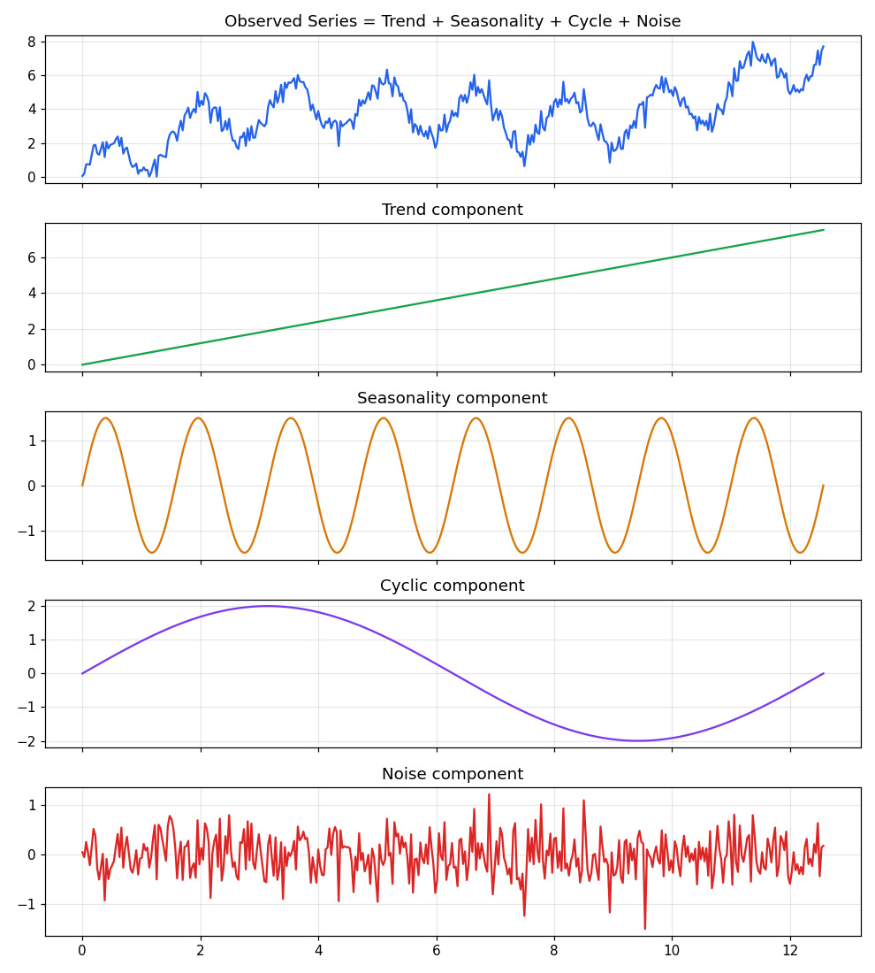
THEORY
Components of a Time Series
Trend Long-term direction
Seasonality Fixed-period cycles
Cyclic Irregular, longer swings
Noise Random variation
2

Slide 3
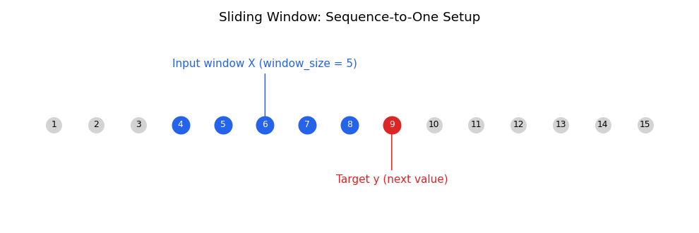
THEORY
Sliding Window Technique
Past window_size values → predict the next single value (sequence-to-one)
3

Slide 4
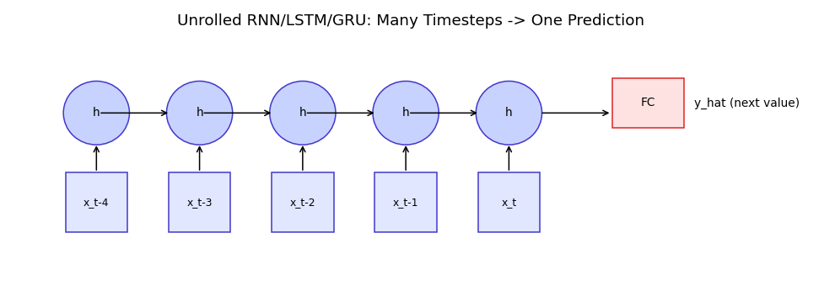
THEORY
Sequence-to-One Modeling
4

Slide 5
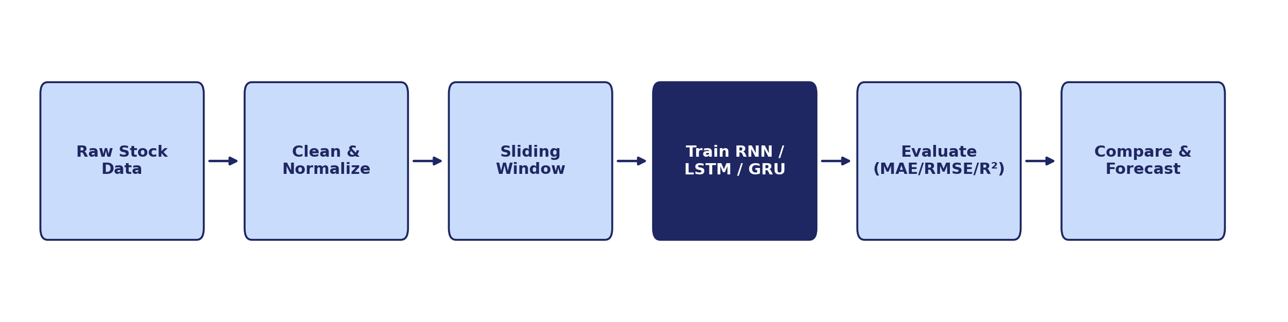
METHODOLOGY
Project Pipeline
Window size = 20 days | Train/Test split = 80/20 (chronological)
5

Slide 6
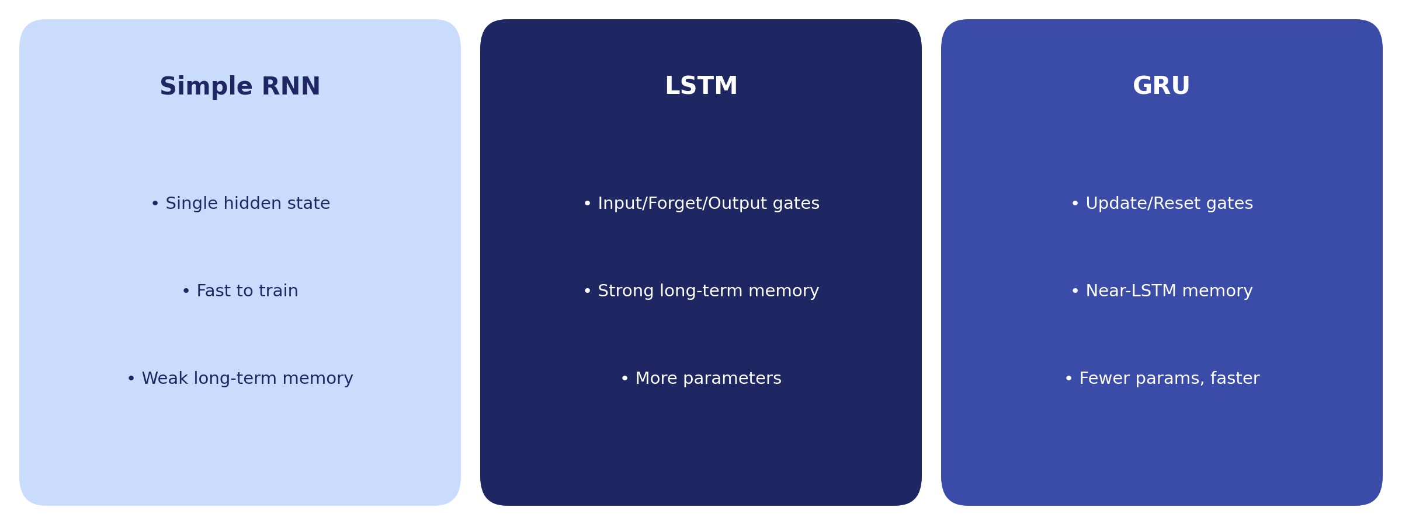
MODEL ARCHITECTURES
RNN vs. LSTM vs. GRU
6

Slide 7
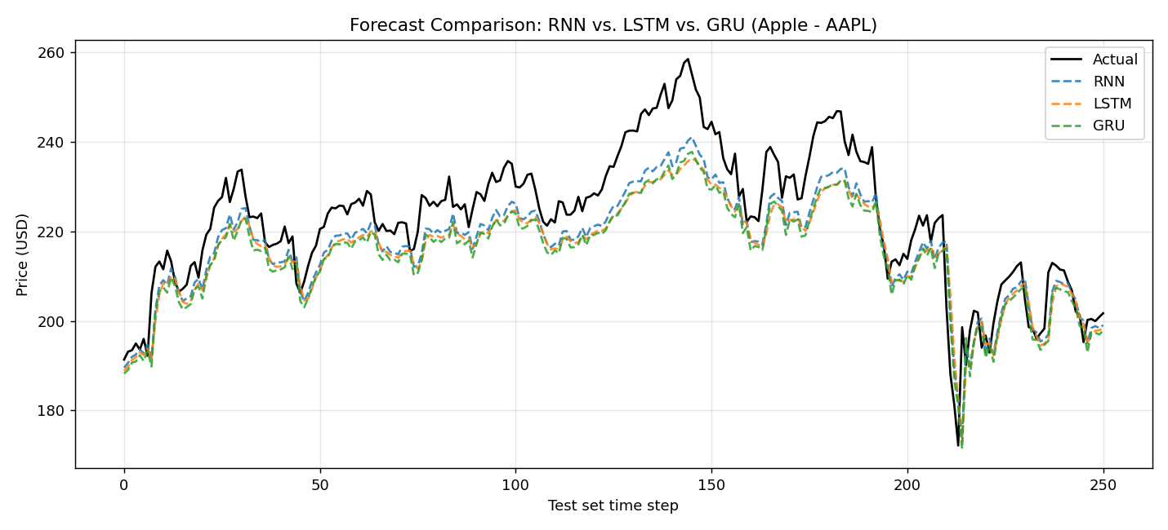
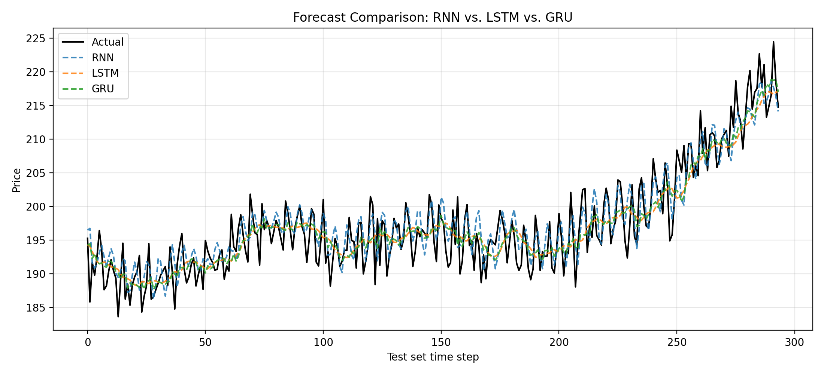
RESULTS
Forecast vs. Actual Prices
7

Slide 8
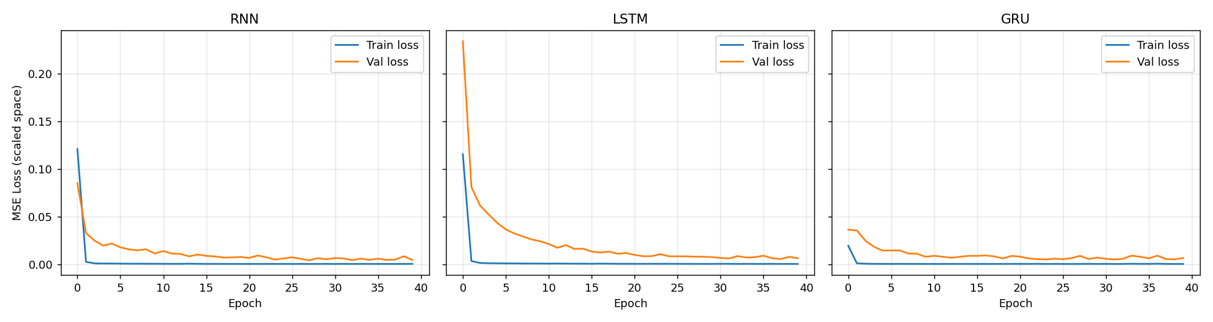
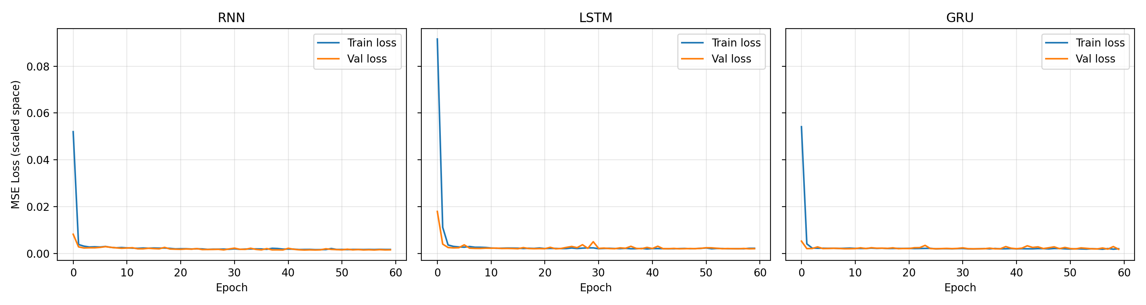
RESULTS
Training vs. Validation Loss
Stable convergence across all three models — no significant overfitting
8

Slide 9
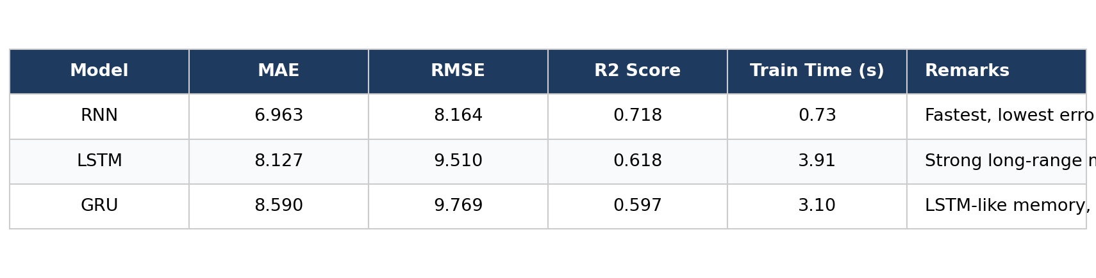
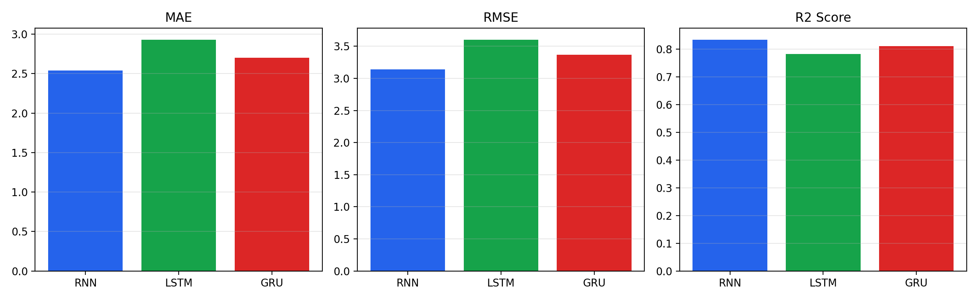
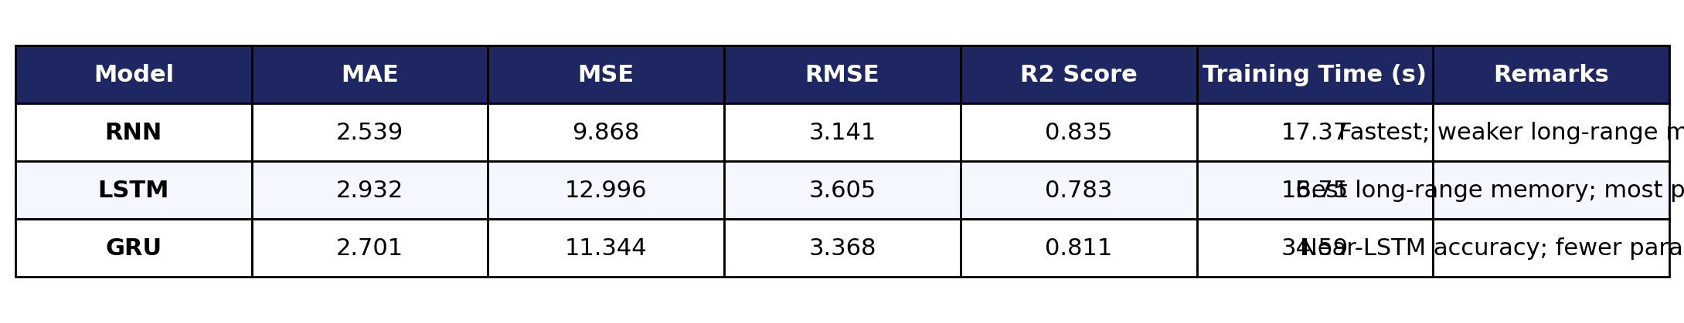
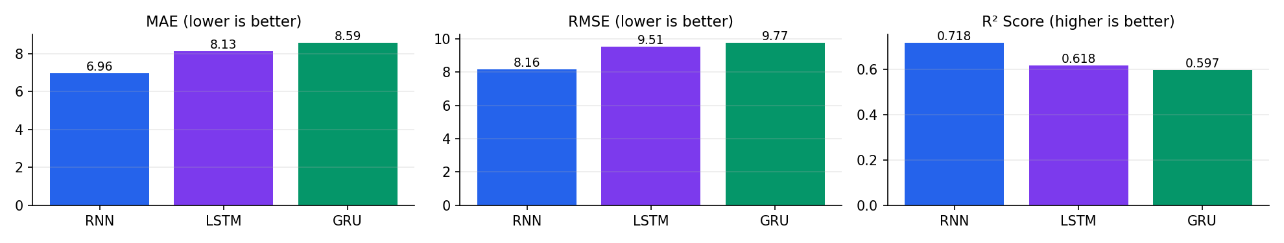
RESULTS
Performance Comparison
9

Slide 10
KEY TAKEAWAYS
Conclusion
LSTM & GRU handle longer-range dependencies better than a simple RNN via gating
GRU matches LSTM accuracy closely while training faster (fewer parameters)
Sequence length is a key trade-off — too short misses patterns, too long risks overfitting
Best model here: RNN selected by lowest RMSE / highest R² (see comparison table)
10

